Slide 1
BIG DATA FUNDAMENTALS
Introduction to Big Data
Data Warehousing and Data Engineering
Data Lake and Delta Lake
ETL Tools

Slide 2
What is Big Data?
Big data is a huge, fast-growing pile of information from all kinds of sources that’s too big for regular tools to handle- but full of insights if you know how to dig in!
The Five V’s:
• Volume: Data in MASSIVE amounts - like Netflix users watch 250 million hours daily
• Velocity: Data moves FAST - Twitter processes 500 million tweets per day in real-time
• Variety: Not just spreadsheets - photos, videos, sensor data, and so on
• Veracity: Is this data even trustworthy?
• Value: The whole point - turning data chaos into business gold
Real world case: Companies like Amazon use your browsing history to predict what you'll buy before you know.

Slide 3
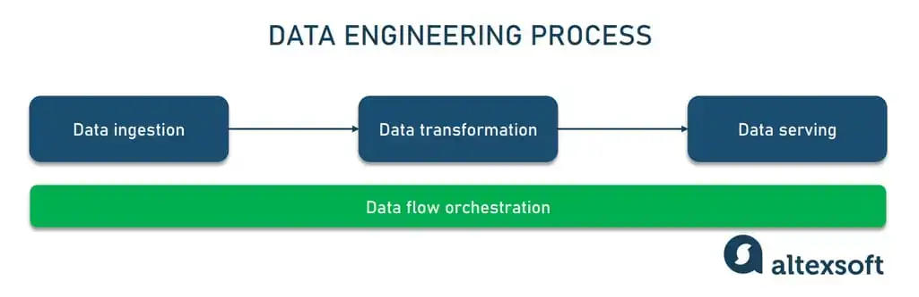
Data Engineering
Data Engineering: The builders
Think of data engineers as the architects and plumbers of the data world.
They design, build, and maintain the systems that move and transform raw data.
Tools: Apache Spark, Airflow, SQL, Python
Goal: Deliver clean, reliable, and fast-flowing data pipelines.

Slide 4
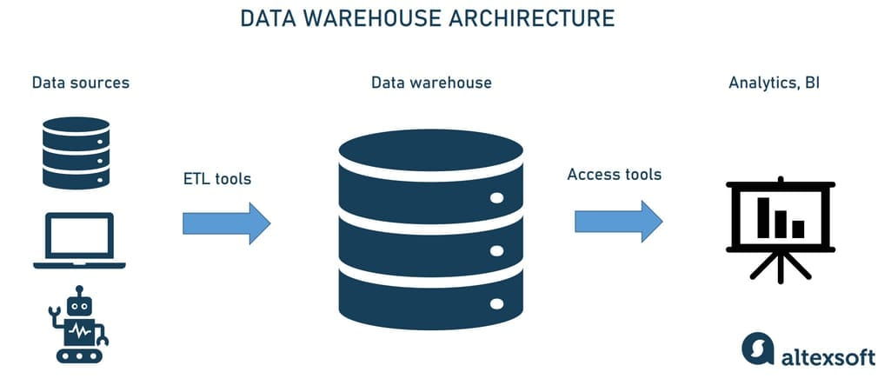
Data Warehousing
Data Warehousing: The data mansion
A data warehouse is like a super-organized digital filing cabinet for all your business data.
It stores structured data from various sources for analysis and reporting.
Popular warehouses: Snowflake, BigQuery, Redshift.
Goal: Make it easy for analysts and decision-makers to find what they need fast.

Slide 5
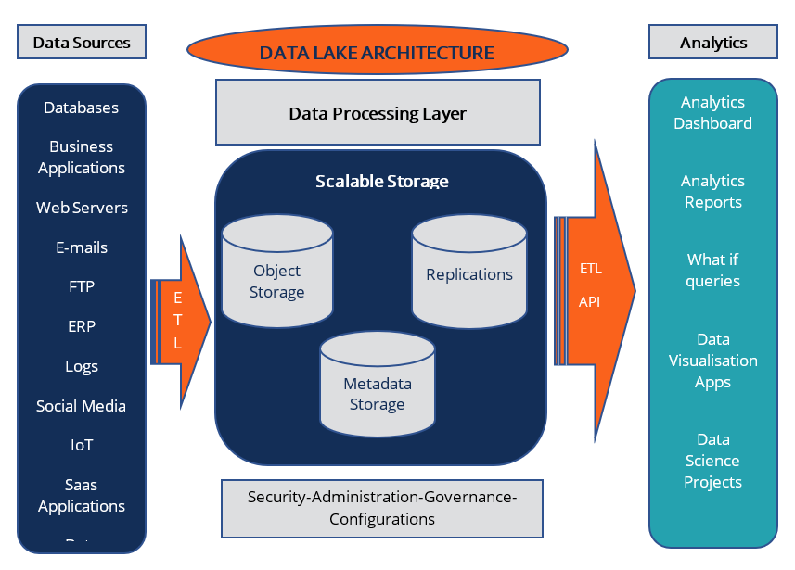
Data Lake
Data Lake
A centralized repository designed to store vast amounts of raw data in its native format.
Supports all data types: structured, semi-structured, and unstructured
Scales cost-effectively and enables advanced analytics and machine learning.
Common technologies: Amazon S3, Azure Data Lake Storage, Hadoop HDFS.

Slide 6
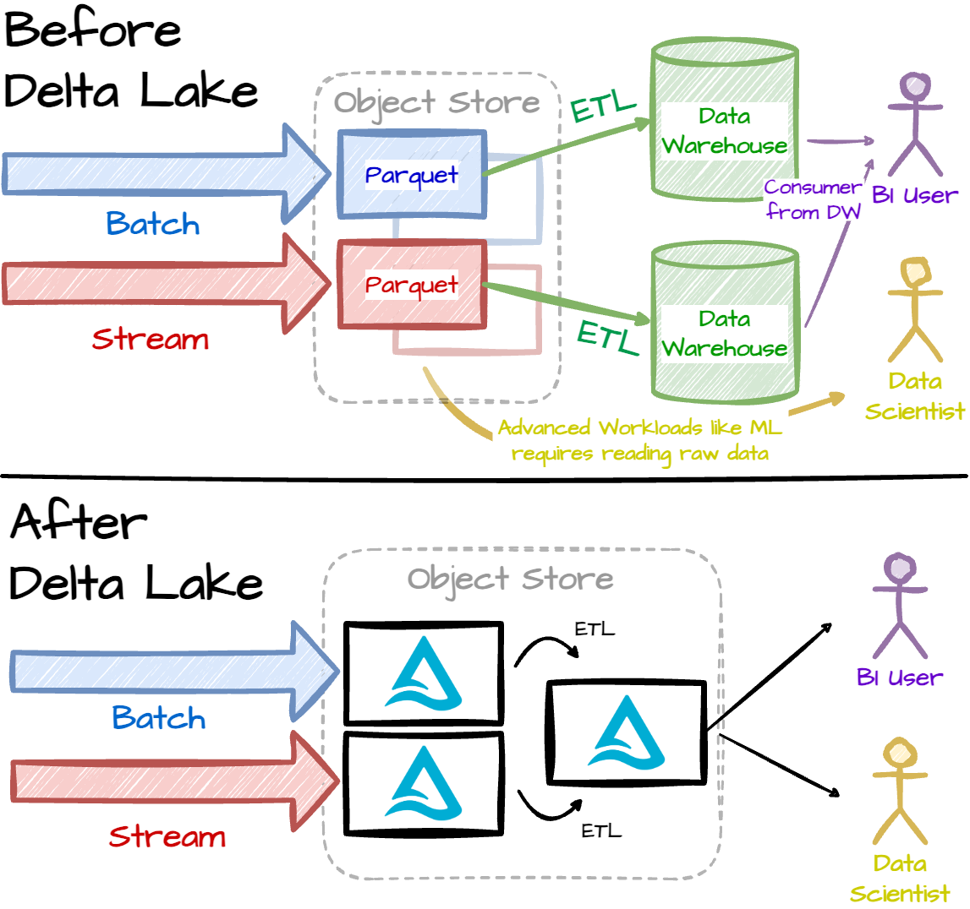
Delta Lake
Delta Lake
An open-source storage layer that brings reliability and performance to data lakes.
Adds ACID transactions, schema enforcement, and data versioning to your existing lake.
Optimized for batch and streaming data workloads.
Built on top of Apache Spark and Parquet files.

Slide 7
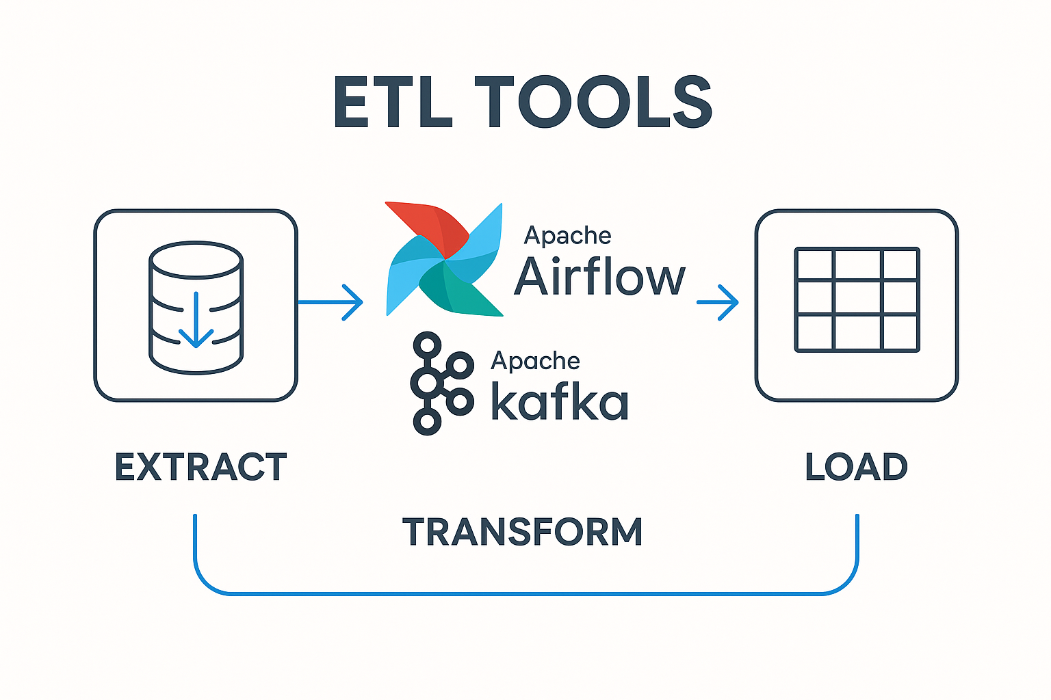
ETL Tools
What Are ETL Tools?
ETL stands for Extract, Transform, Load - a key process for moving data from source systems into destinations like data warehouses or data lakes.
ETL tools automate this process to ensure data is clean, consistent, and ready for analysis.
Why They Matter
They save time by automating repetitive data tasks.
Make it easier to build reliable data pipelines that scale as your data grows.
Essential for powering dashboards, reports, and machine learning models.

Slide 8
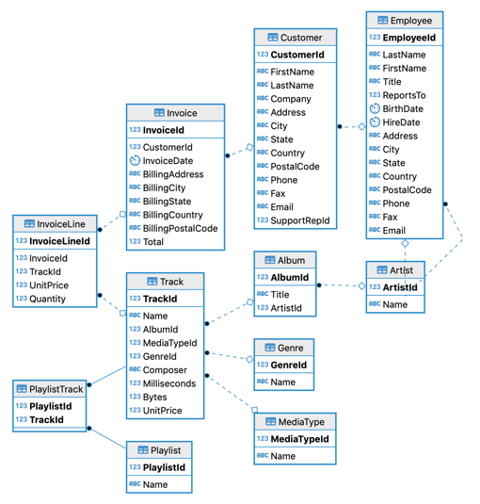
SQL Hands-on (PostgreSQL)
Using Chinook Database:
https://github.com/lerocha/chinook-database/blob/master/ChinookDatabase/DataSources/Chinook_PostgreSql.sql

Slide 9
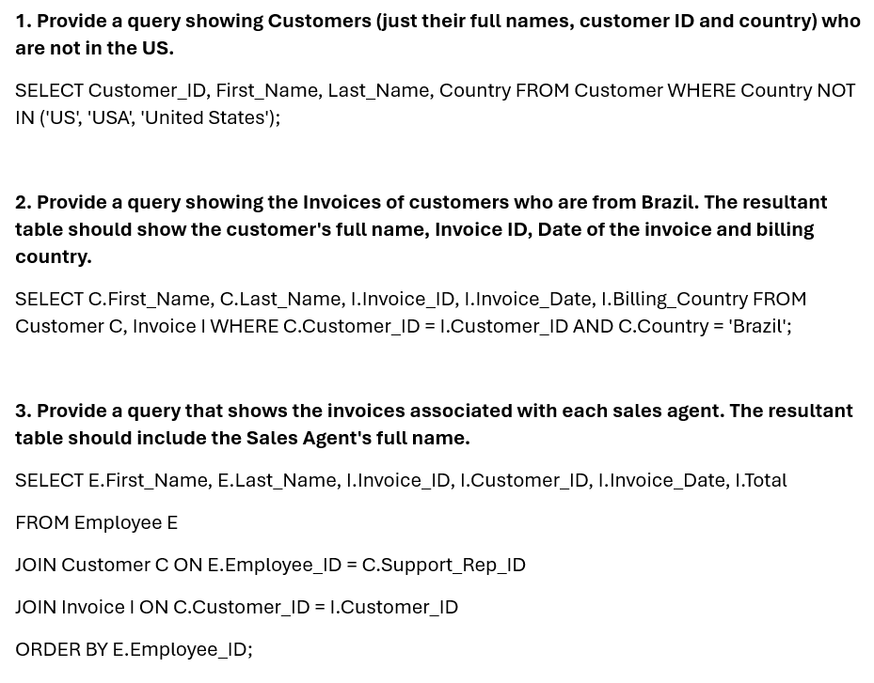
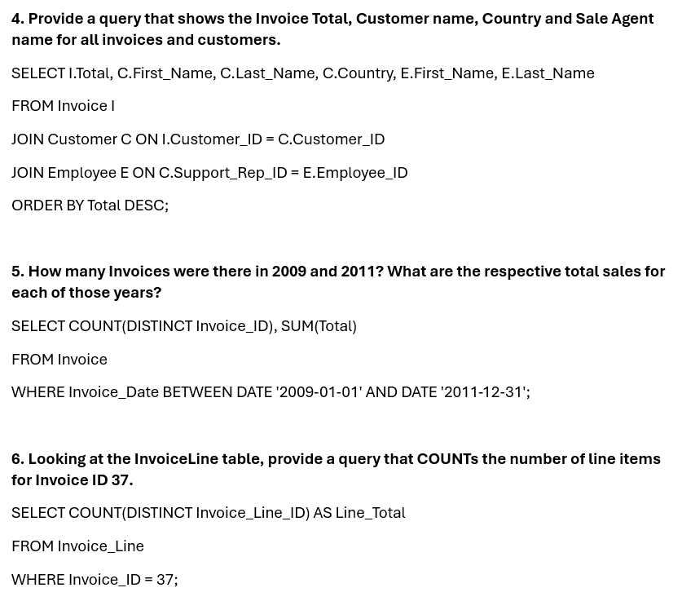
SQL

Slide 10
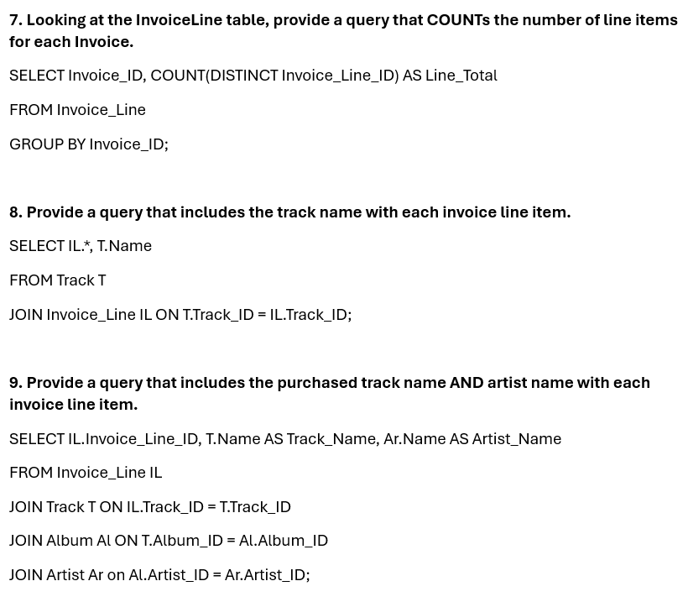
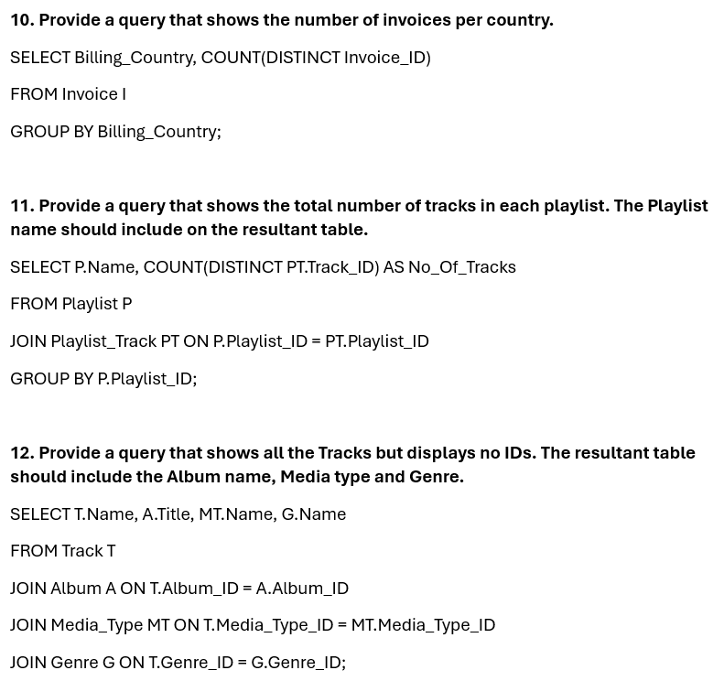
SQL

Slide 11
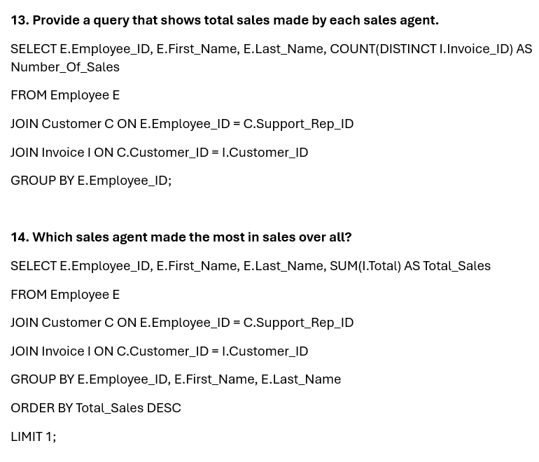
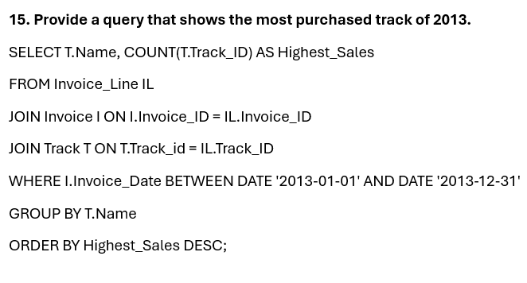
SQL

Slide 12
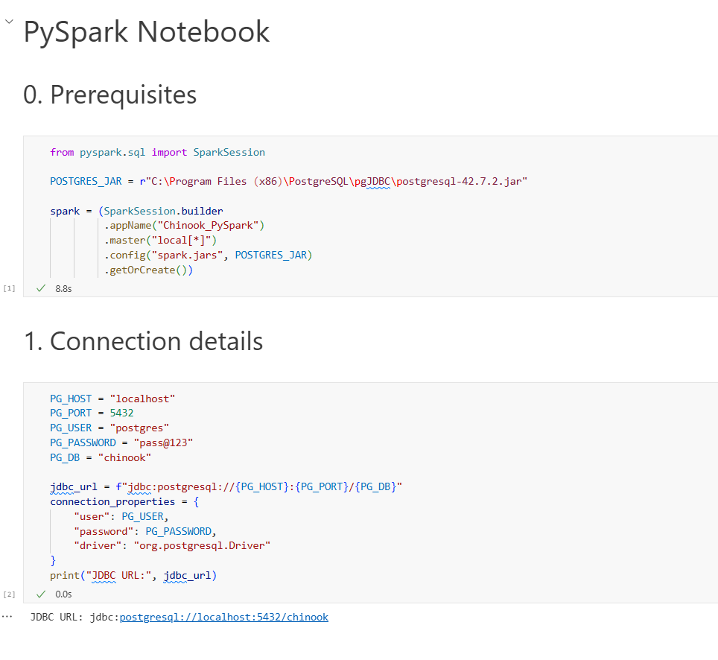
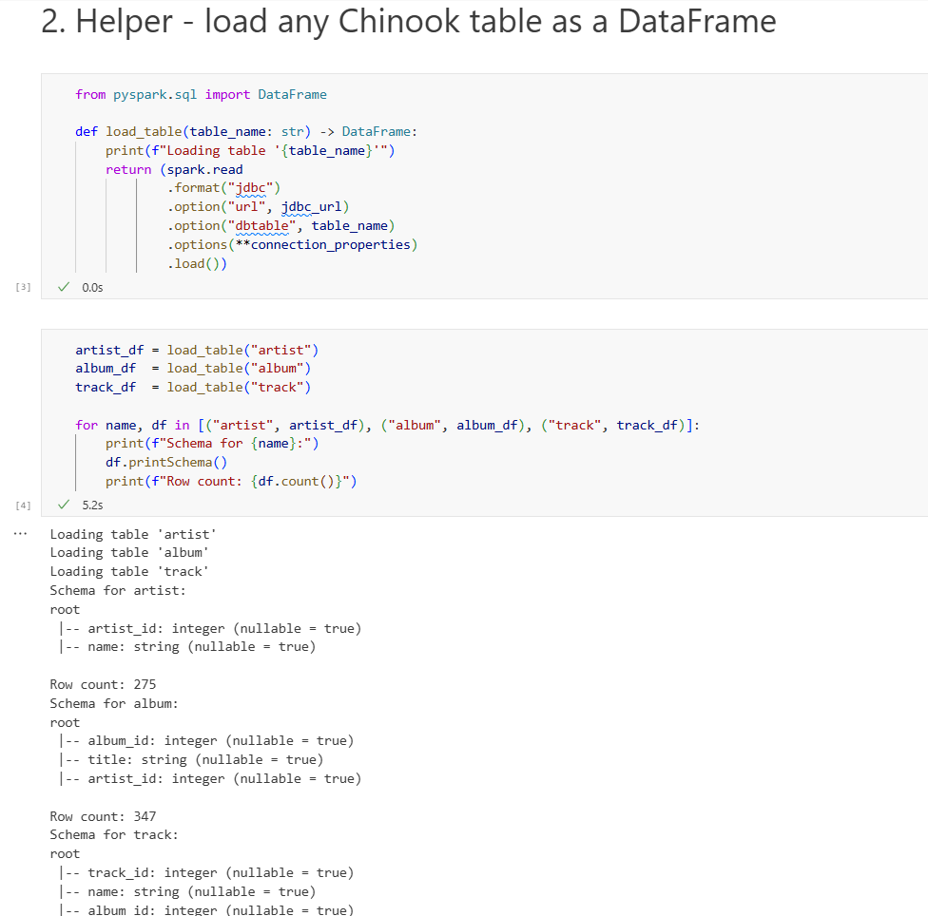
PySpark Hands-on

Slide 13
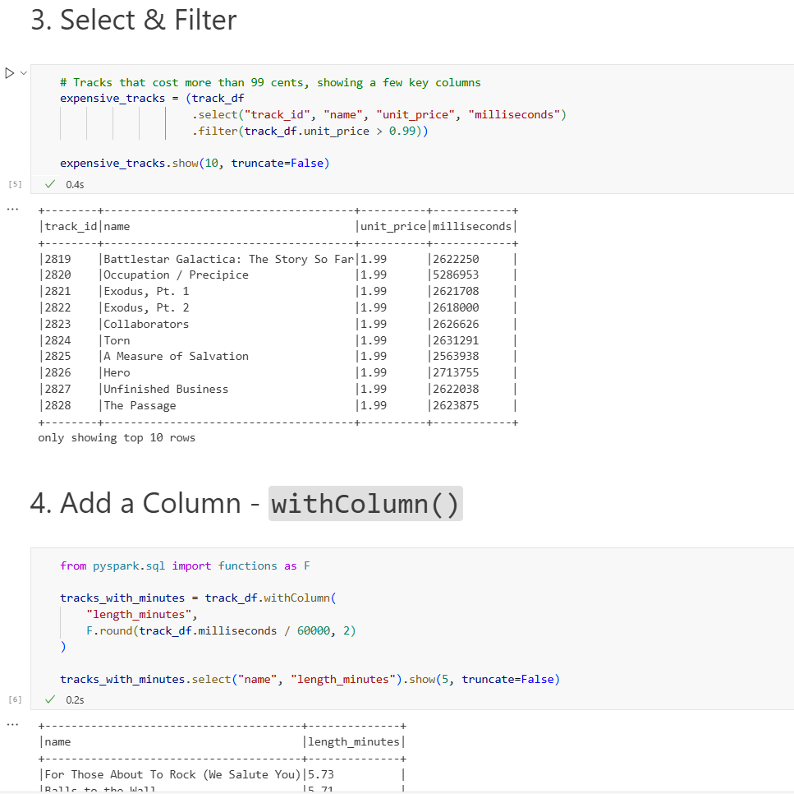
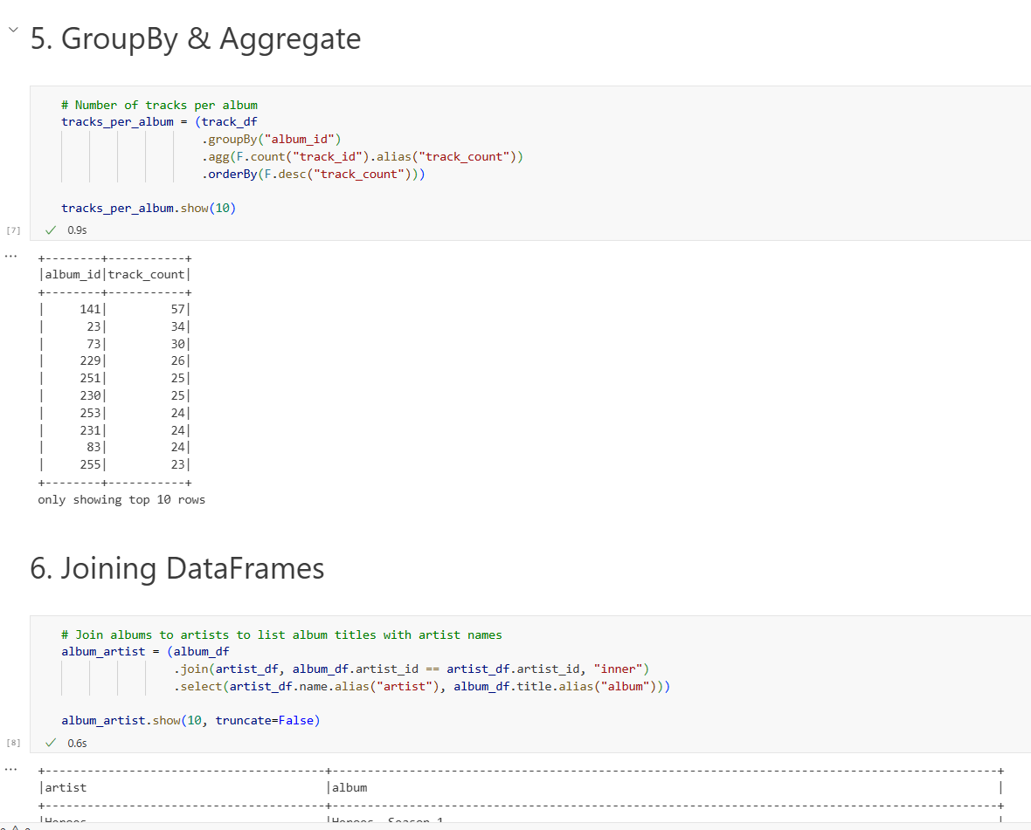
PySpark

Slide 14
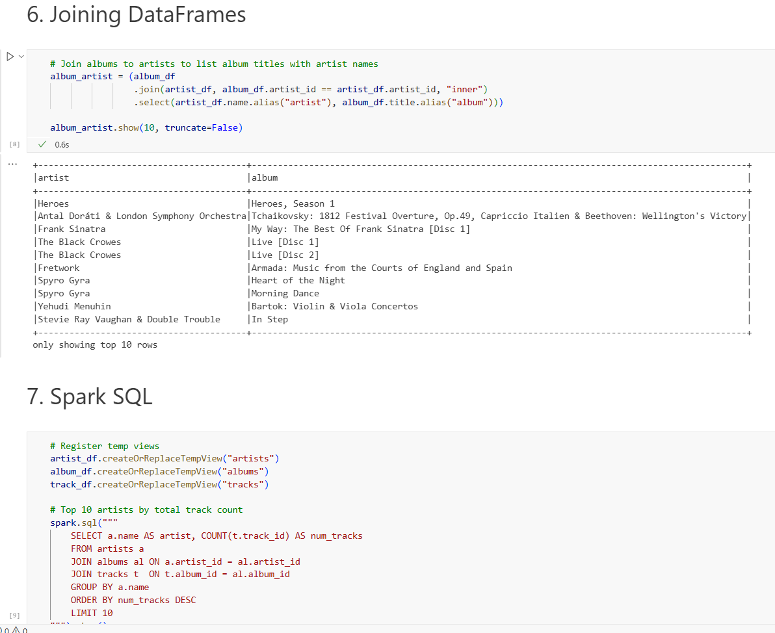
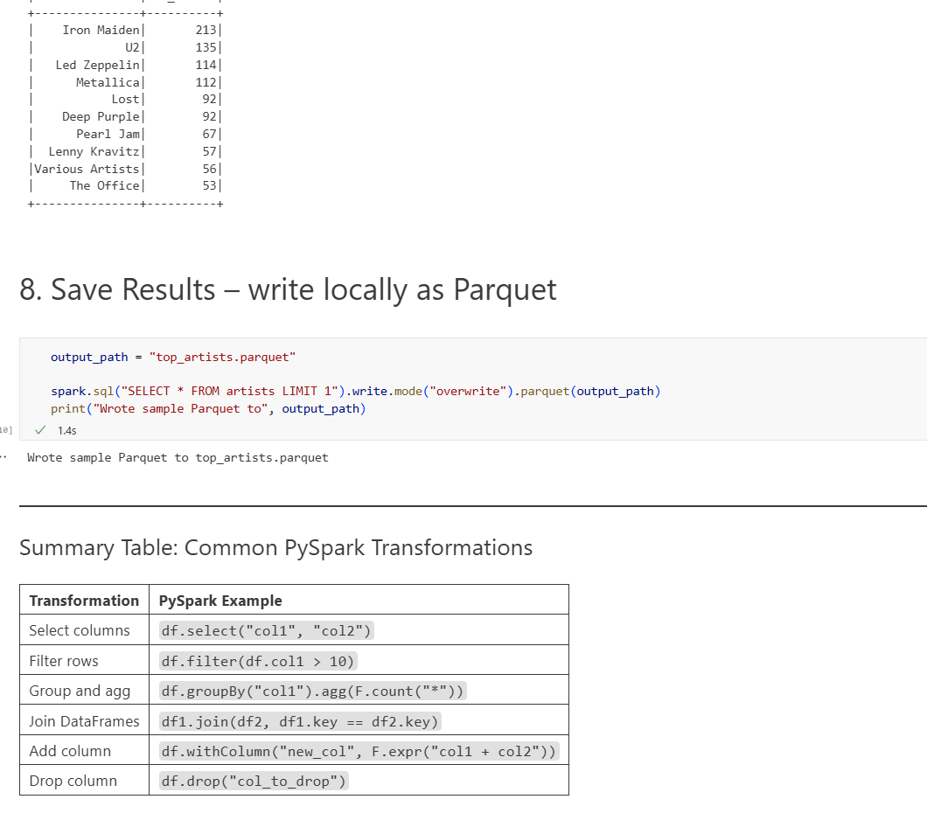
PySpark

